Slide 1
Introduction to Bioimage Analysis
Thursday 30 Mar 2023
Jitender
Marielle
informatics@jic

Slide 2
Agenda
10:00 Start and Introduction
Overview
Concepts
11.15 am Coffee
Exercises
3:00pm Coffee

Slide 3
Content
General Introduction
Core concepts in bioimage analysis and interpretation
Introduction to image formats and conversion
Pre-processing: cropping, correction, and filtering
Image segmentations methods with hand-on exercises
Lunch Break
eMeasurement and Phenotype classification using intensity and spatial information
Case studies: highlighting morphological metrics that can be extracted from images
Quick detour to supervised machine learning based classifying (phenotypes) in images.
Best Practices and discussion

Slide 4
https://github.com/gitbackspacer/bioimage

Slide 5
Material
http://training.scicomp.jic.ac.uk/docs/bioimaging_course_book
http://training.scicomp.jic.ac.uk/docs/advanced_image_analysis_book
\\jic-hpc-data\Project-Scratch\training\image-analysis-course\PPT
https://www.unige.ch/medecine/bioimaging/files/3714/1208/5964/CellCounting.pdf
https://cildata.crbs.ucsd.edu/media/images/36420/36420.tif
https://imagej.github.io/presentations/fiji-introduction/#/8
https://monashmicroimaging.github.io/gitbook-fiji-basics/demonstration_images.html
https://rawgit.com/JeremyPike/image-analysis-with-fiji/master/ImageAnalysisWithFijiSlides.pdf

Slide 6
Introduction
Biology is data driven
Primary source is images:
optical/Fluorescence imaging or electron, EM
MRI
From collection of images
Suitable image to show a property
“Process to extract Quantitative data”: tools, techniques and Pitfalls
Data

Slide 7
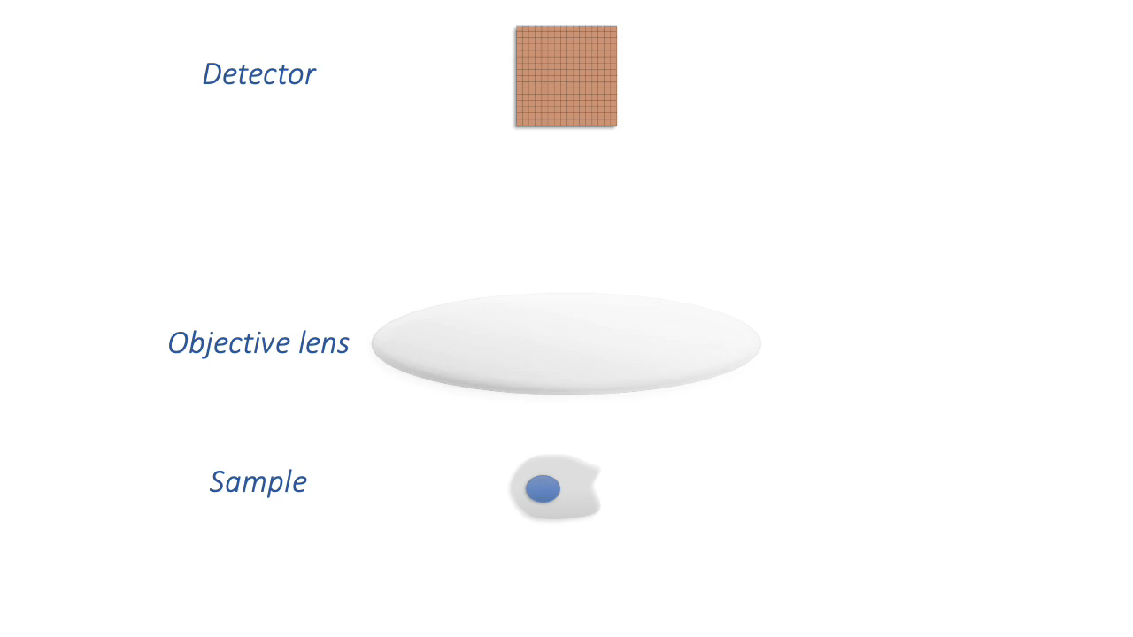
From microscope to data
“Maximising information capture”
Photon to Pixels
pixel values in a fluorescence image depend upon “numbers of detected photons”
Images cant be perfect: blurred and noisy
Source: https://bioimagebook.github.io/chapters/3-fluorescence/1-formation_overview/formation_overview.html

Slide 8
“most that the image can tell us is how much light was emitted from any particular point from a sample”
infer
Presence feature, about the size and shape of a structure or relative concentration of a molecule.

Slide 9
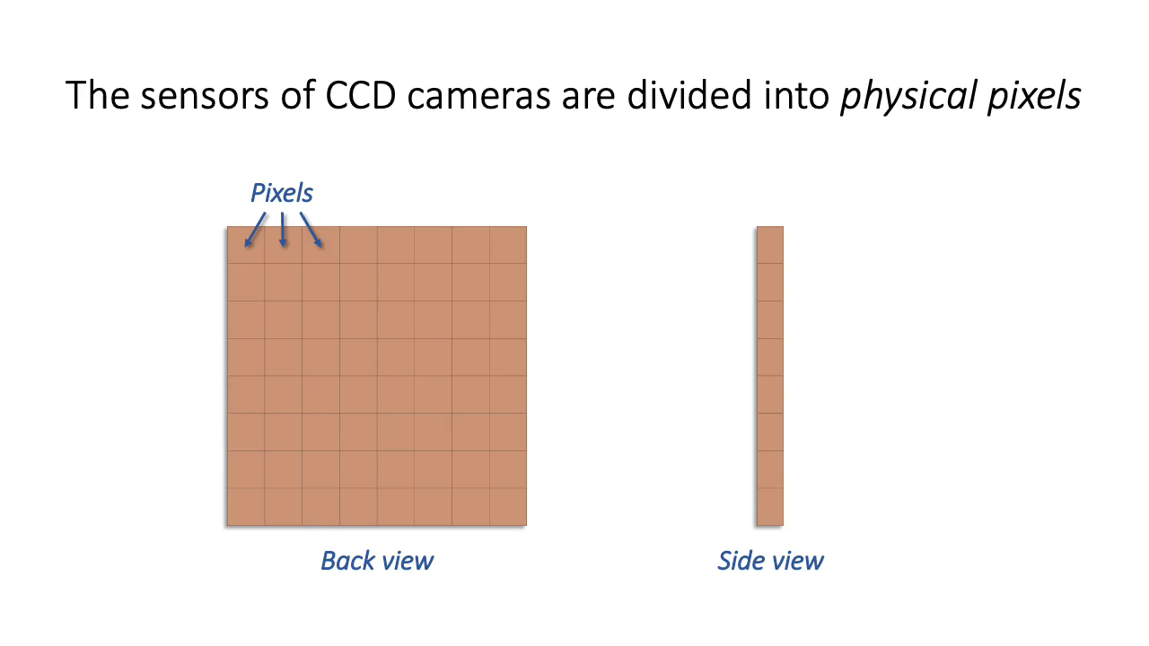
Pixel values being stored in a digital image
“Photon hits”

Slide 10
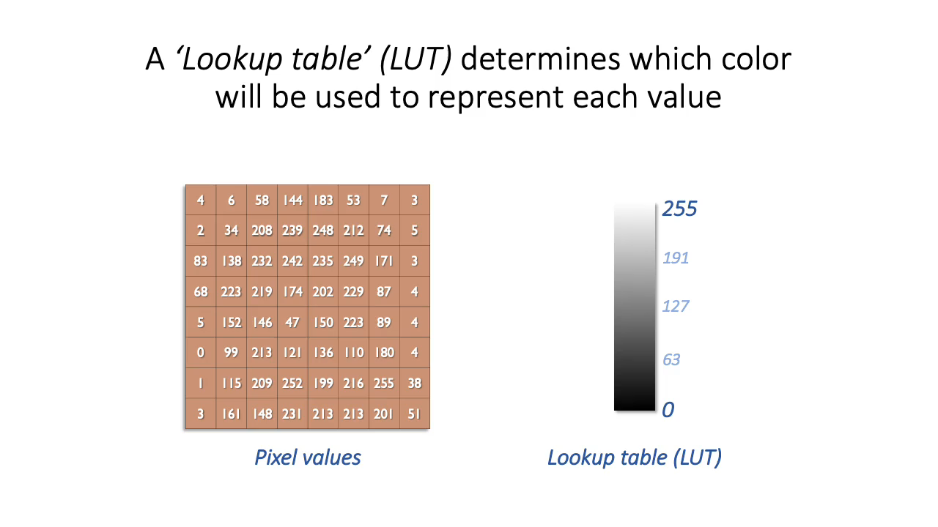
LUT: change the appearance of an image without changing its pixel values.

Slide 11
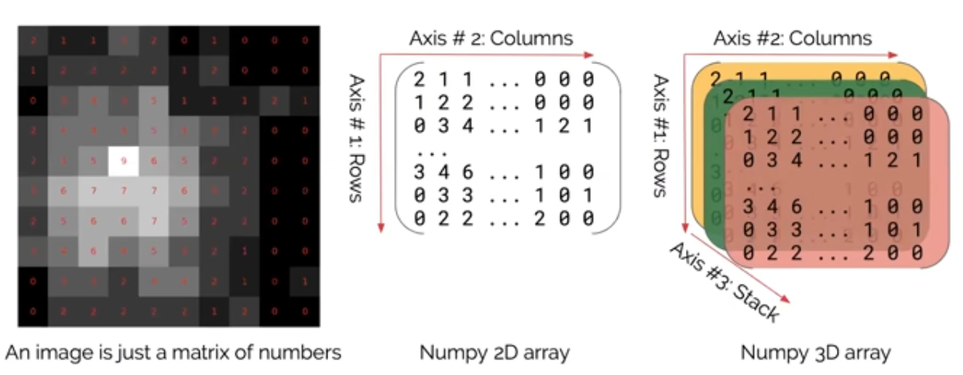
https://www.youtube.com/watch?v=2KF8vBrp3Zw

Slide 12
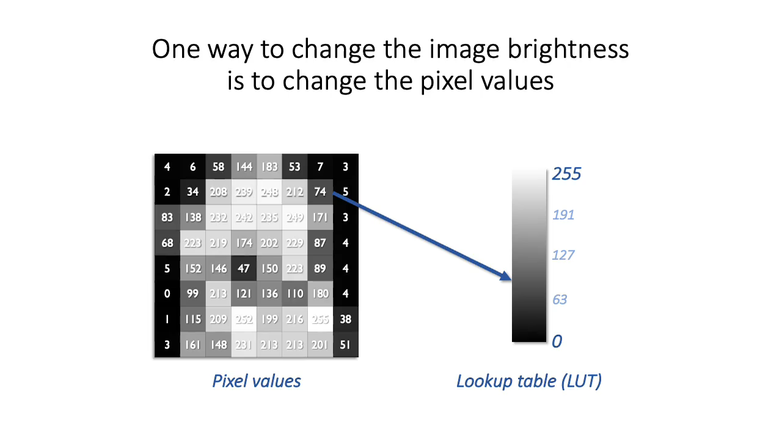

Slide 13
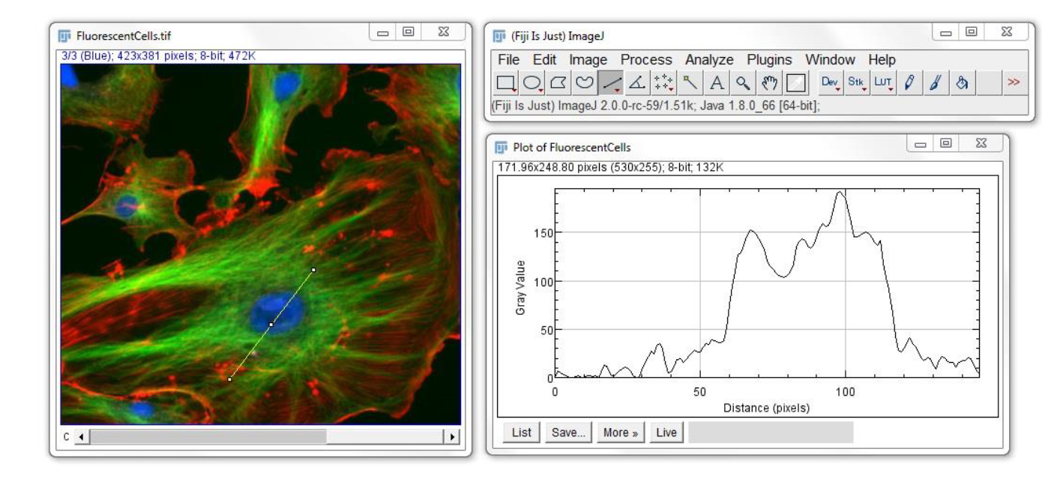
Basics

Slide 14
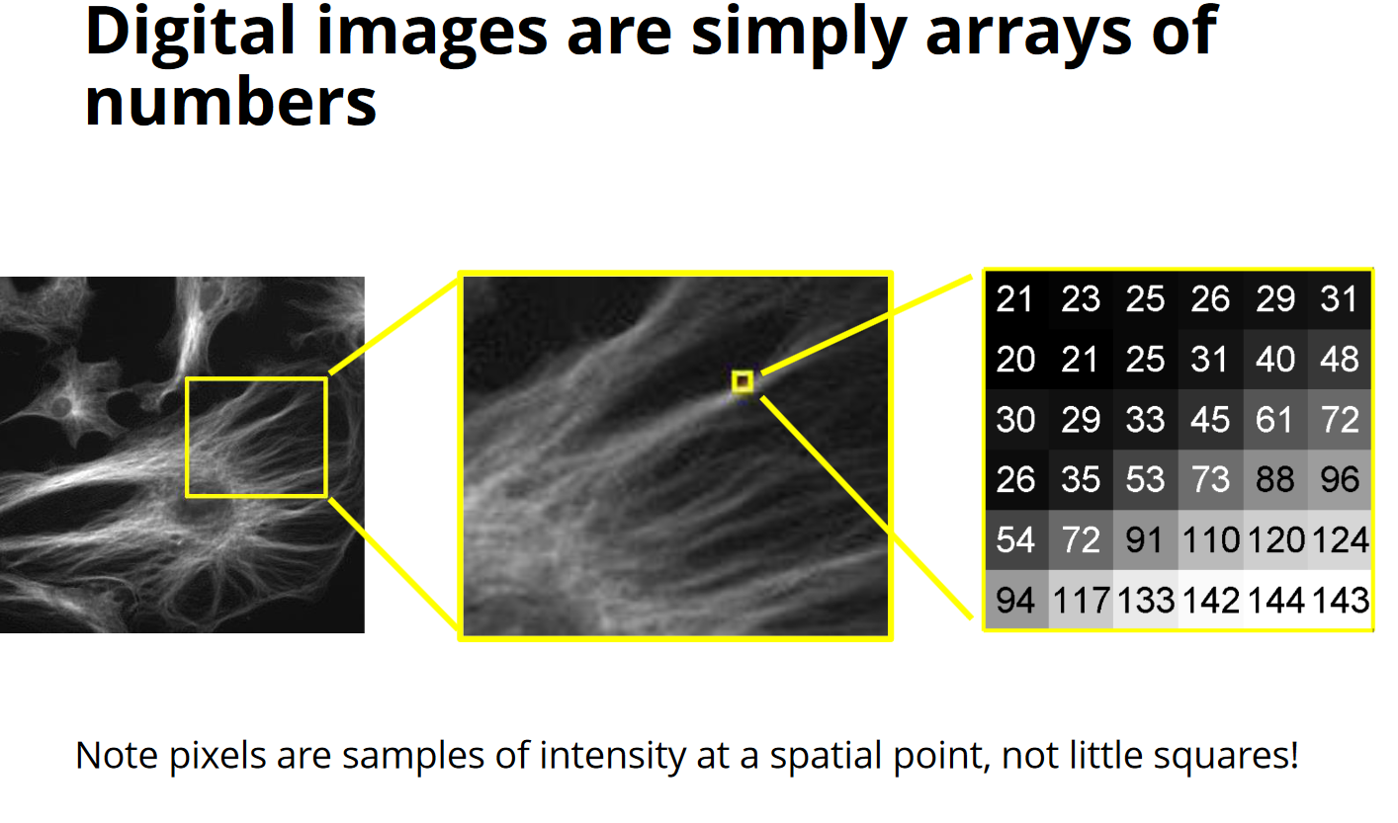

Slide 15
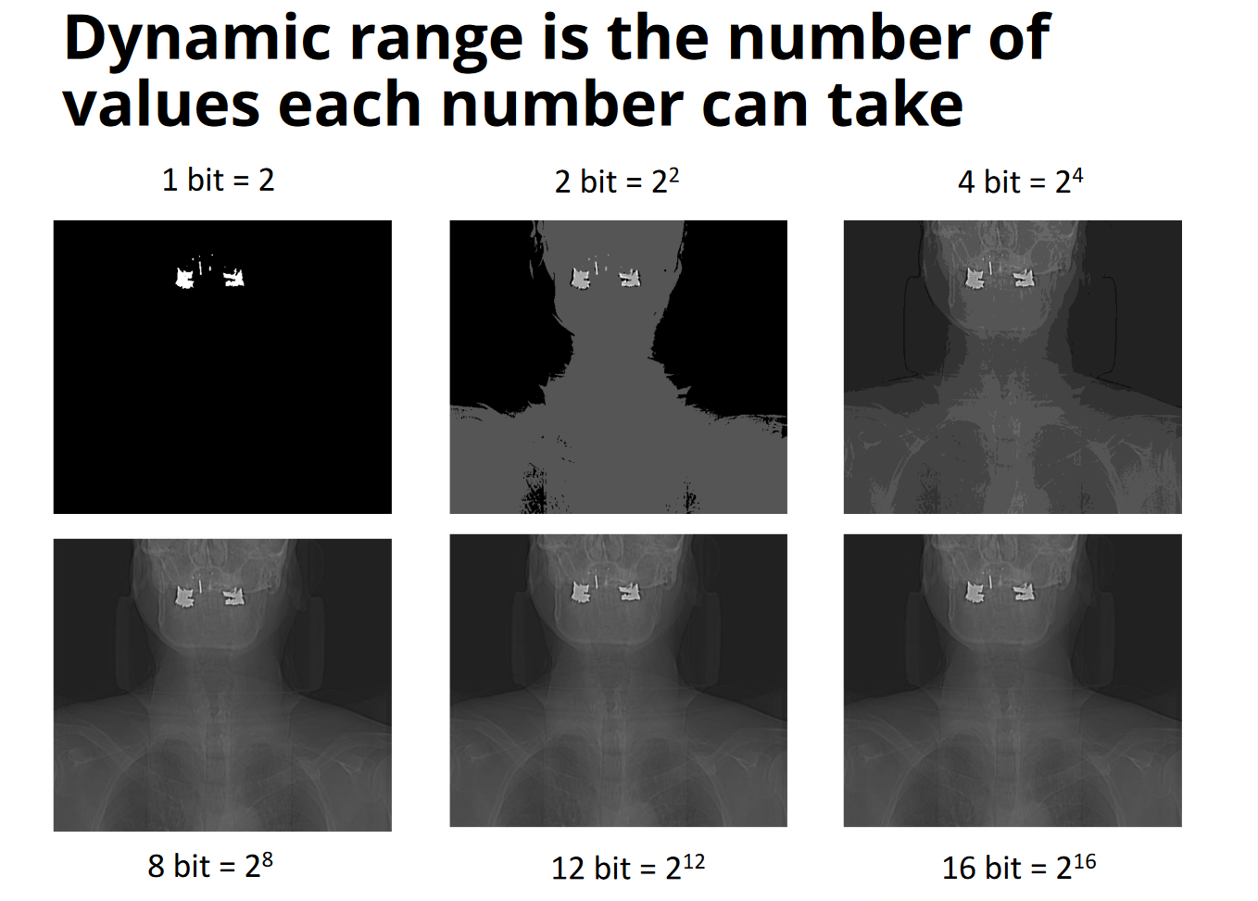

Slide 16
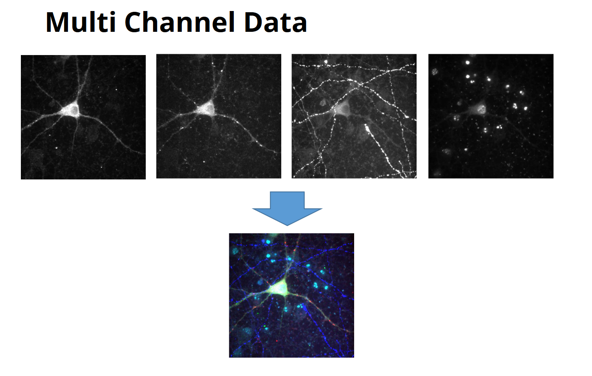

Slide 17
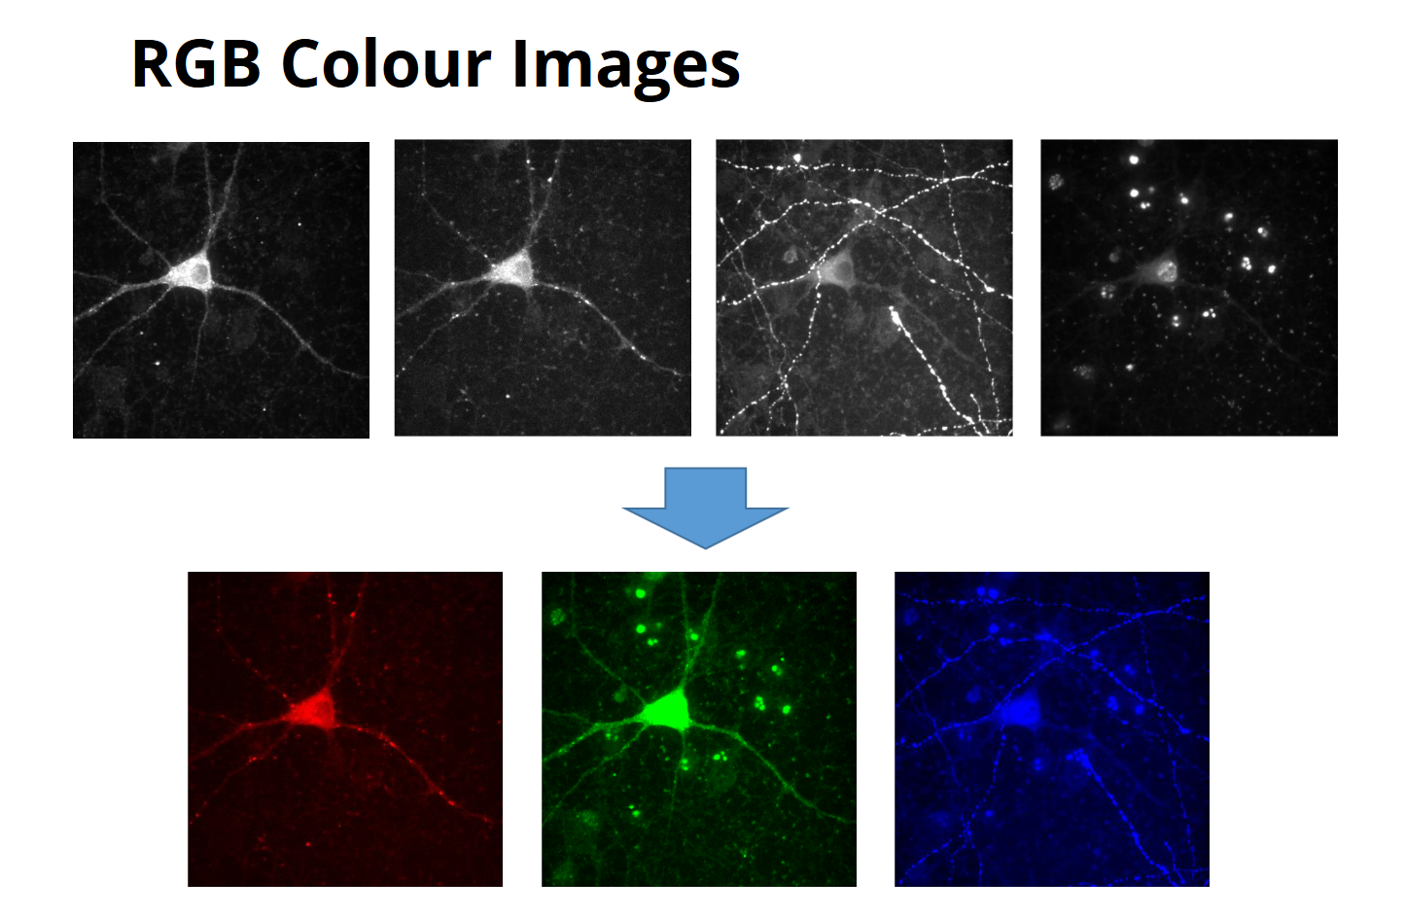

Slide 18
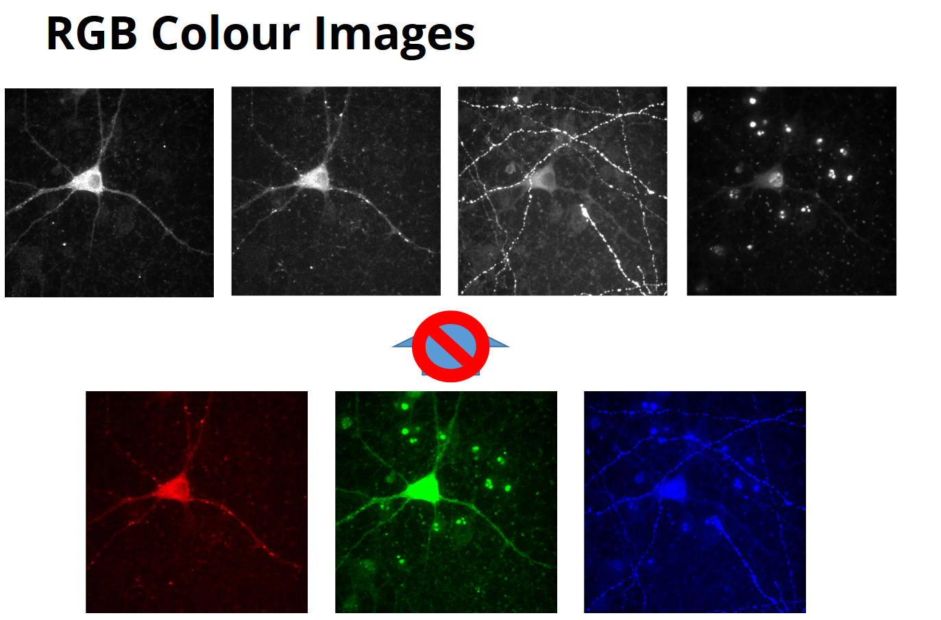

Slide 19
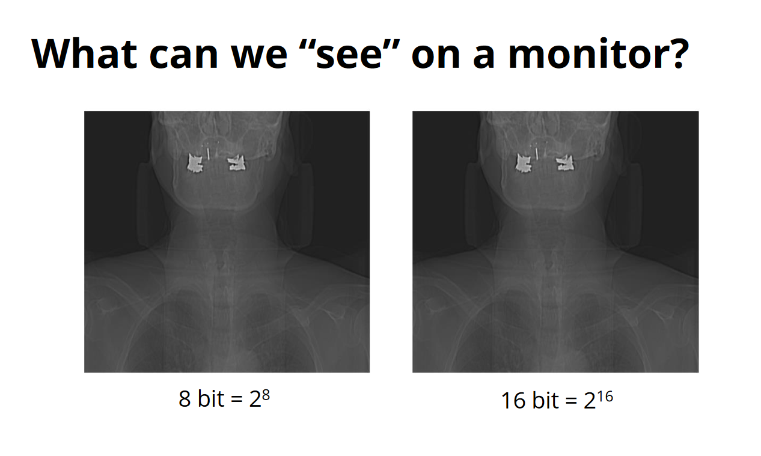

Slide 20
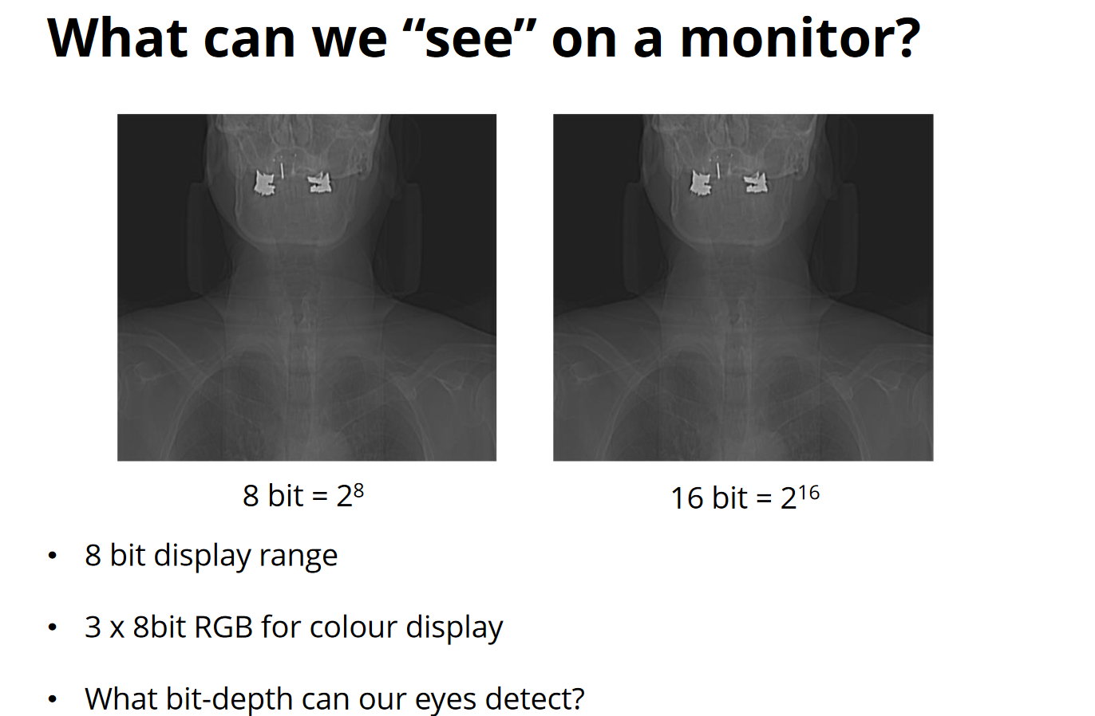

Slide 21
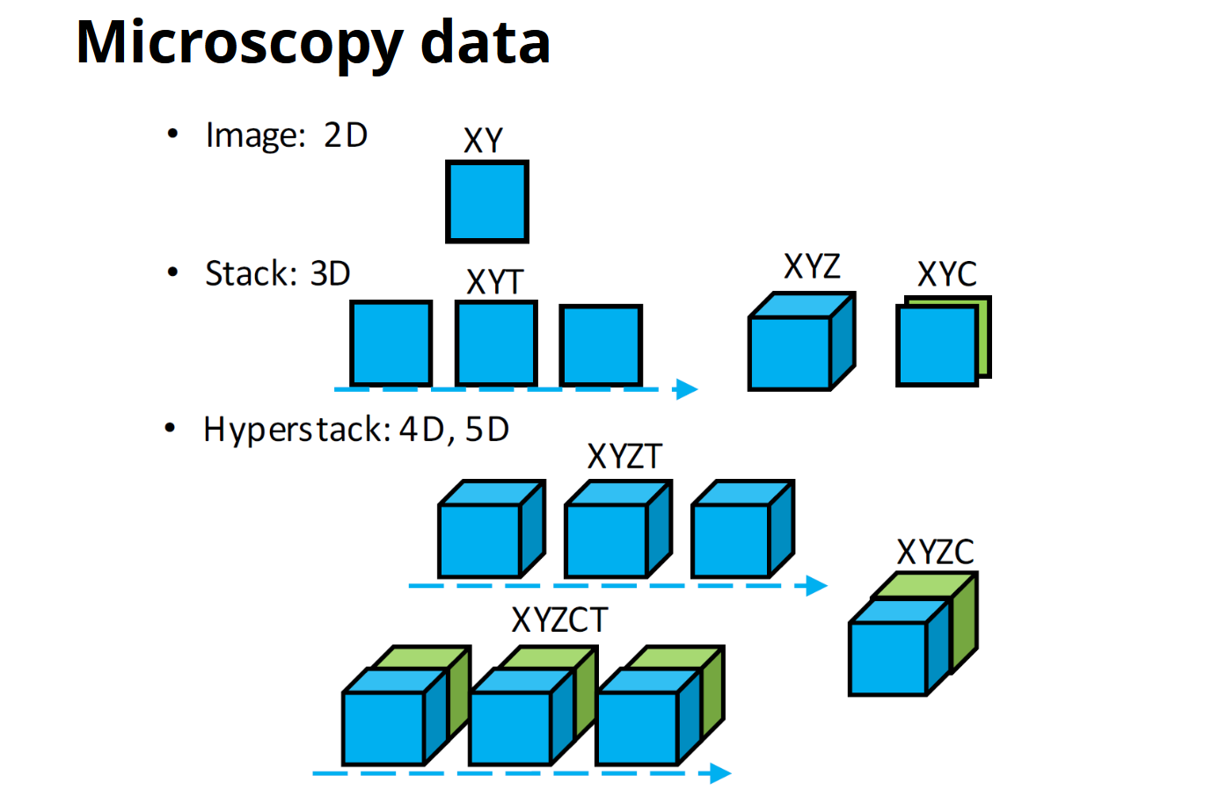

Slide 22
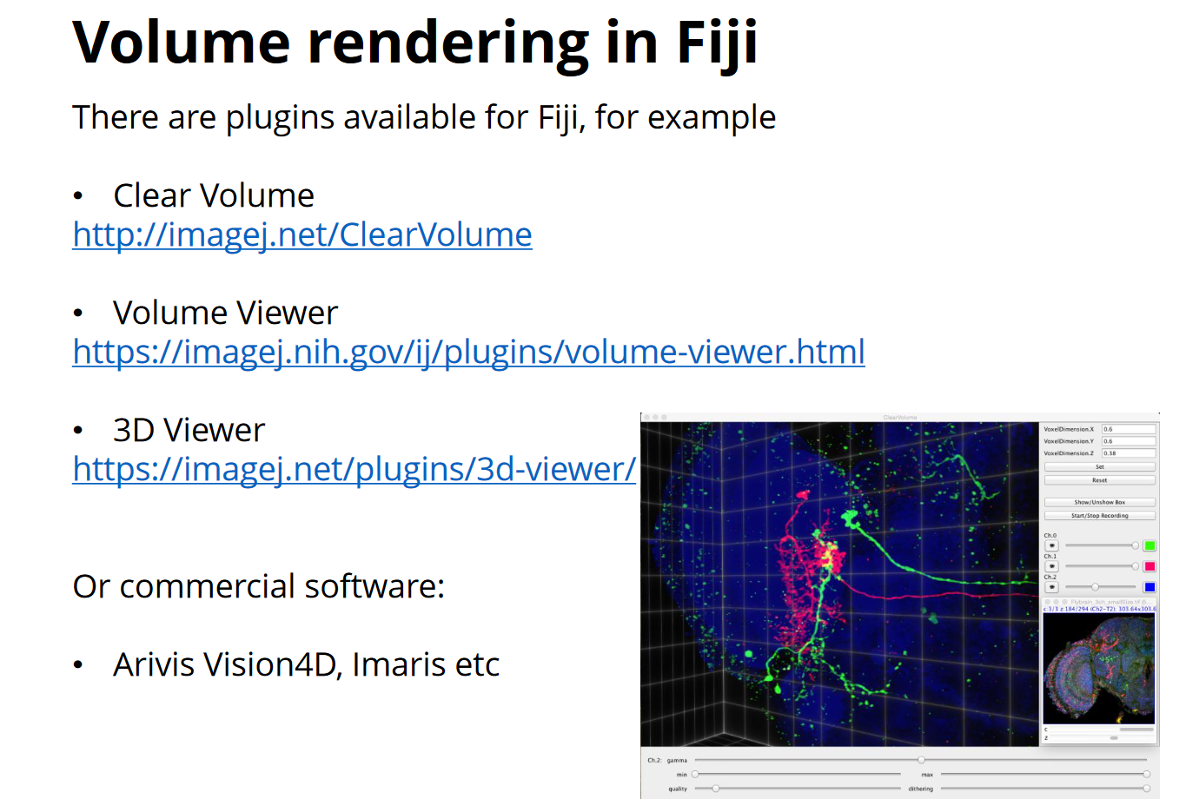

Slide 23
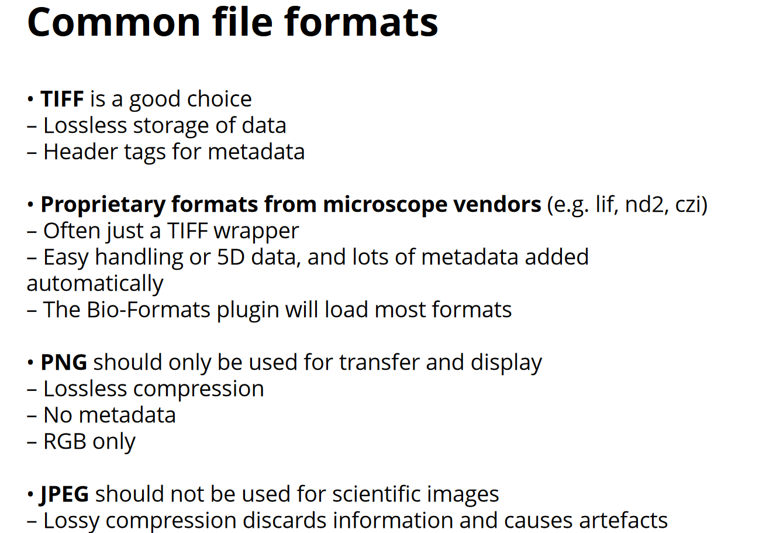

Slide 24
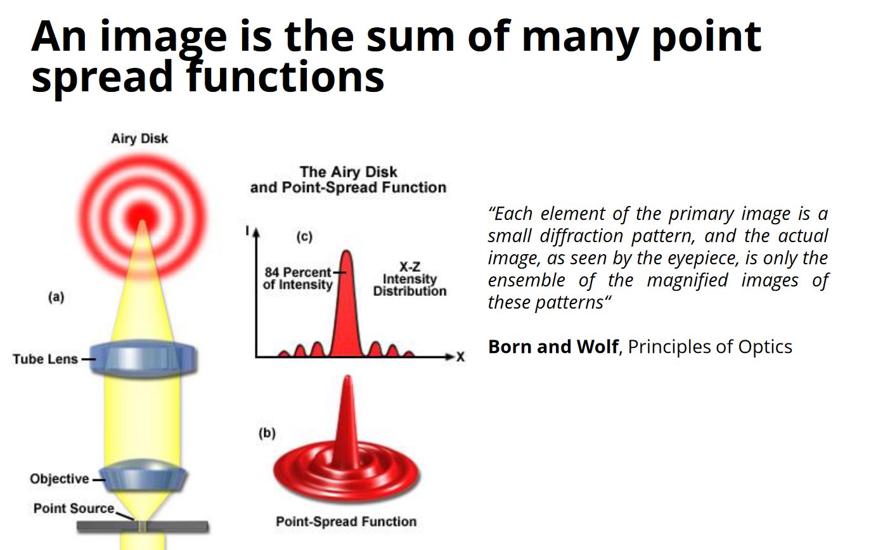

Slide 25
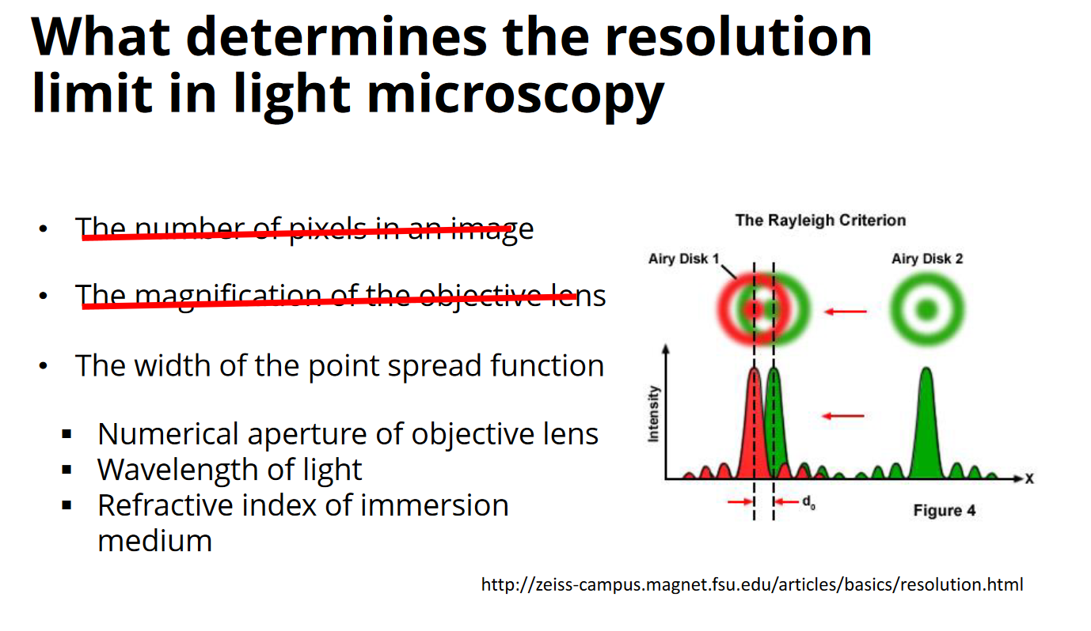

Slide 26
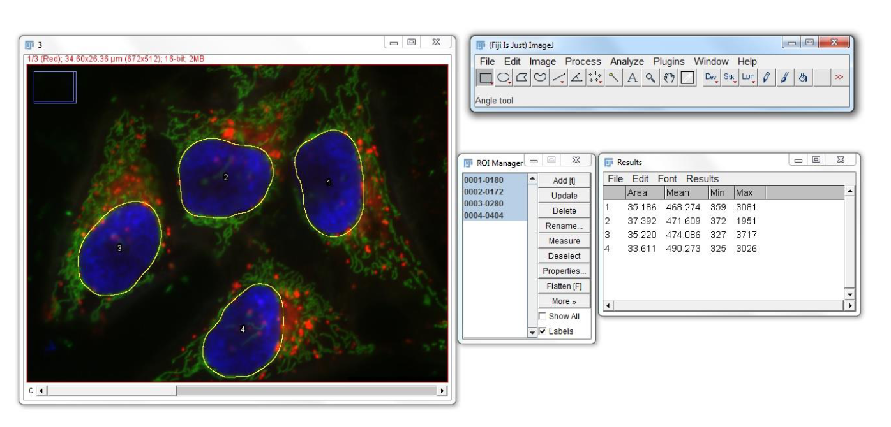
Processing and Analysis

Slide 27
Maximising information capture
Sufficient resolution in spatial and/or temporal dimensions:
e.g. cell divisions Frequency of capture high enough
Sufficient range in spatial and temporal dimensions;
multiple images of the same sample in different position and experiment last long enough
Sufficient dynamic range to capture values of interest:
Intensity ranges in images: Intensity ranges in images

Slide 28
Microscope files
Zeiss microscopes produce .lsm files
Leica microscopes: .lif.
Effectively a single microscope file contains multiple two dimensional images.
Confocal microscope data tends to be organised as follows:
One or more time series (often denoted by T)
One or more channels (often denoted by C)
One or more data series (often denoted by S)
Z stacks (vertical height data, denoted by Z)

Slide 29
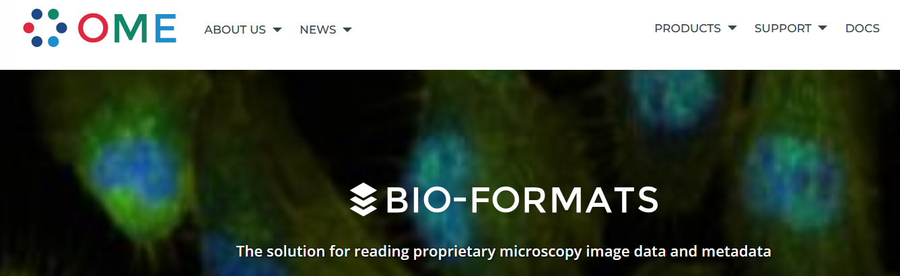
Reading formats
Restrictive Manufacturer’s software
Problem of the wide range of alternative formats for imaging data, a group of scientists and software developers created a library (a set of software tools) for managing life sciences image file formats.
Bio-formats
Bio-Formats is a standalone library or tool for reading and writing life sciences image file formats. It is capable of parsing both pixels and metadata for a large number of formats, as well as writing to several formats.

Slide 30
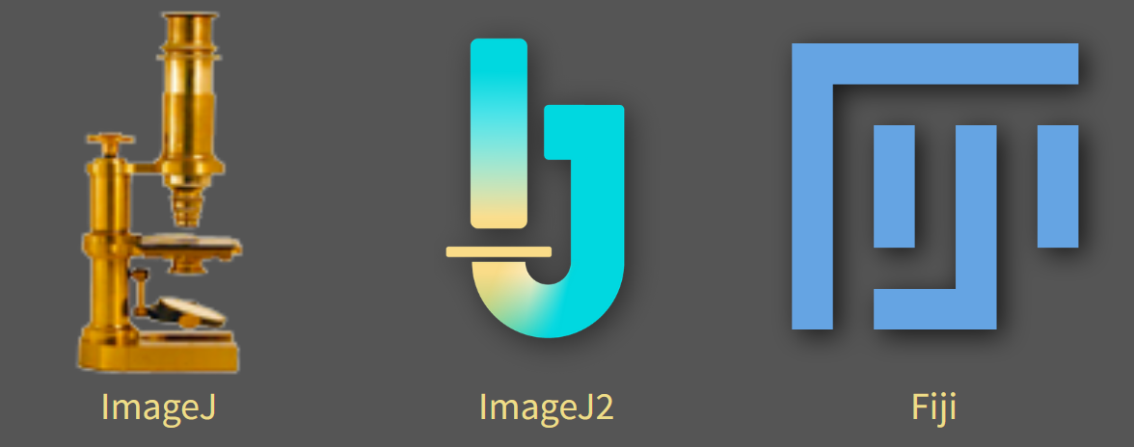
ImageJ and Fiji (https://imagej.net/)
ImageJ Java free and open source program for working with images.
It was originally developed at the US NIH It is designed to be easily extensible, so that people can write plugins to extend its functionality.
Due to it’s popularity, there are a very wide range of plugins available, making it extremely useful for image processing. These plugins include the ability to load files through Bioformats, thus enabling ImageJ to handle microscope files.
Fiji (short for Fiji Is Just ImageJ) is a bundle containing ImageJ, the Java components needed to run it, and a collection of useful plugin

Slide 31
Image measurements
Extracting quantitative data
Distance measurements
Intensity measurement (presence of a tagged substance (a protein) that we’re interested in)
Counting objects (number of cells in an image)
Segmenting : common segmentation algorithm is the watershed algorithm. Fiji includes a wide range of segmentation algorithms

Slide 32
Processing images
Images might be noisy, focus might not be accurate, the image might be under- or over-exposed and so on.
Often we can compensate for some of these problems with image capture by later processing.
Lossless versus lossy operations (operation is not reversible) smoothing and sharpening

Slide 33
Processing images
Edge detection; feature detection, enhance the visibility of edges within an image. Help further processing of the image, trying to perform operations that depend on recognition of cell wall (such as segmentation).
Removing noise; slightly noisy in image capture, we remove remove pixel noise using Gaussian blur or filter
Effectively this averages the value of each pixel with its neighbours, causing it to be ‘spread out’.

Slide 34
Changing intensities
Optical capture devices have a dynamic range, which is the range of light intensities over which they can capture data.
Careful selection of the dynamic range allows to achieve the best either too “bright” or “dark”.
Thresholding, two values in which one value indicates the presence of signal and the other its absence

Slide 35
Errors and imprecisions
most photons do not reach/register the detector
Uncertainty in space; light originating from a particular point cant be a single point focus:
end up being spread over several pixel “Blur”
Uncertainty in brightness
random variations in brightness everywhere throughout the image

Slide 36
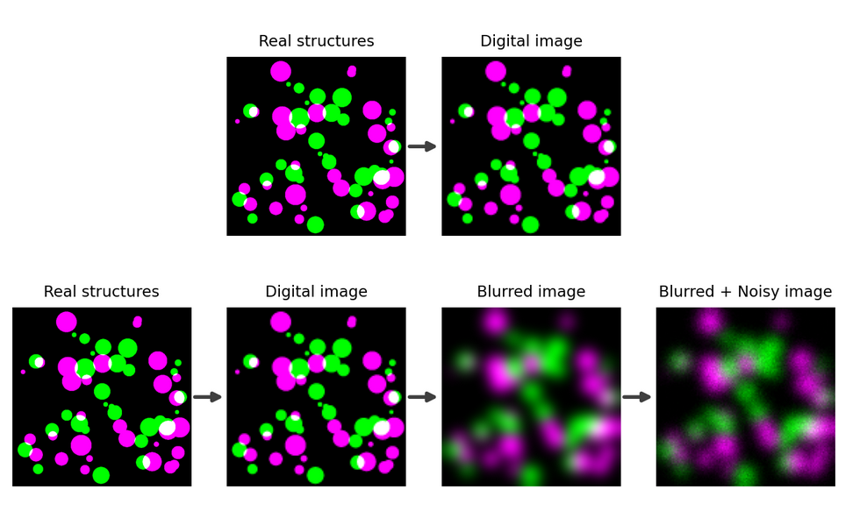
Blurry and Noisy
blur can cause us to misjudge the size of something by several hundred nm
https://bioimagebook.github.io/chapters/3-fluorescence/2-formation_spatial/formation_spatial.html

Slide 37
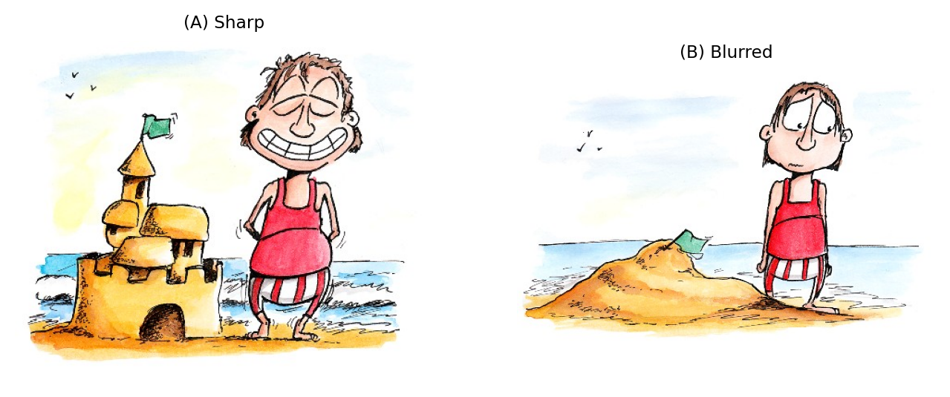
Sandy photons
Blurrrrr
apparent size,
intensity (brightnesses) and number of structures
Well understood ☺
https://bioimagebook.github.io/chapters/3-fluorescence/2-formation_spatial/formation_spatial.html

Slide 38
Mass processing of data Fiji
script the analysis of our data using Fiji’s internal scripting system.

Slide 39
Exercise: Images as numerical data
Loading an image
We’ll start with one of the sample images in Fiji. Load the gel image by navigating through the following menu options:
File -> Open Samples -> Gel
Then save it as a “text image” as follows:
File -> Save As -> Text image
Try opening the file in a text editor. What do you see?
Visualising the image
http://training.scicomp.jic.ac.uk/docs/bioimaging_course_book/exercise-images-as-data.html

Slide 40
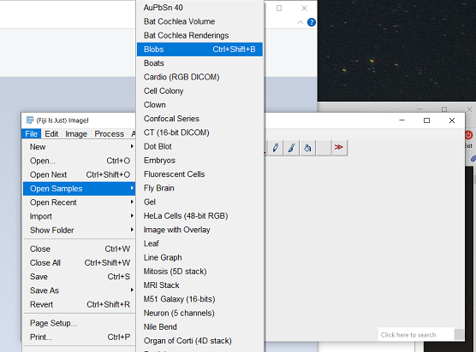
Image Segmentation with Fiji
Filter
Segment
Analysis

Slide 41
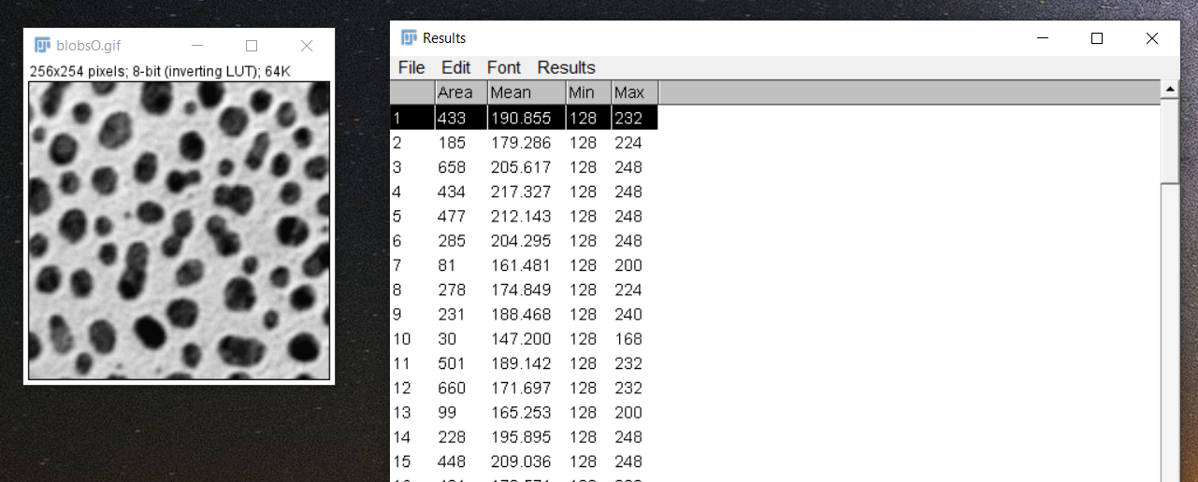
Counting

Slide 42
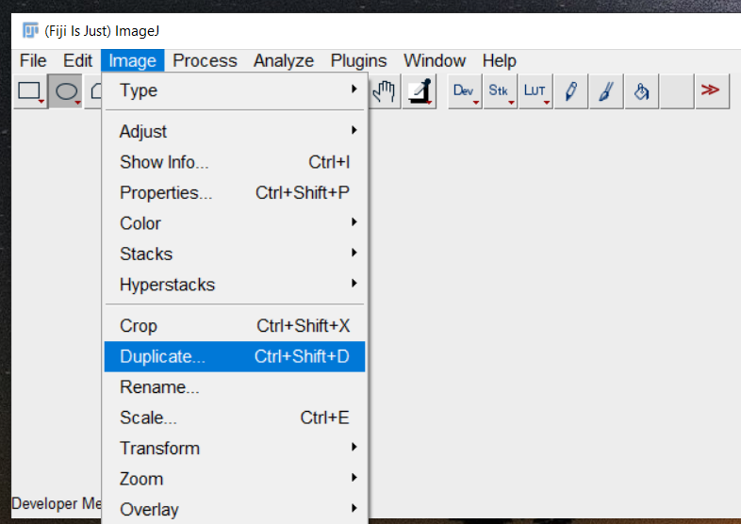
Duplicate

Slide 43
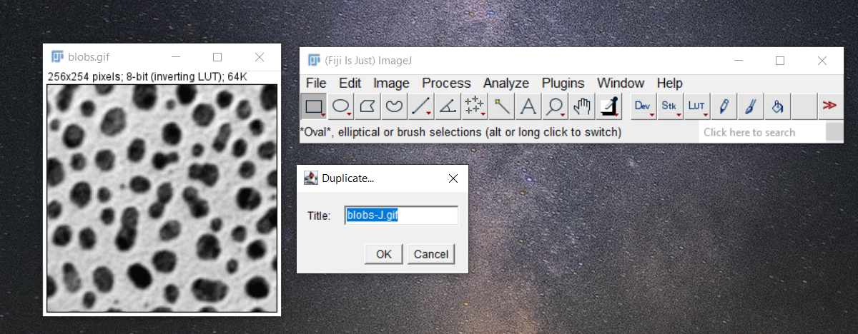
Make a copy of Original sample Image
Renamed to blob-J.gif

Slide 44
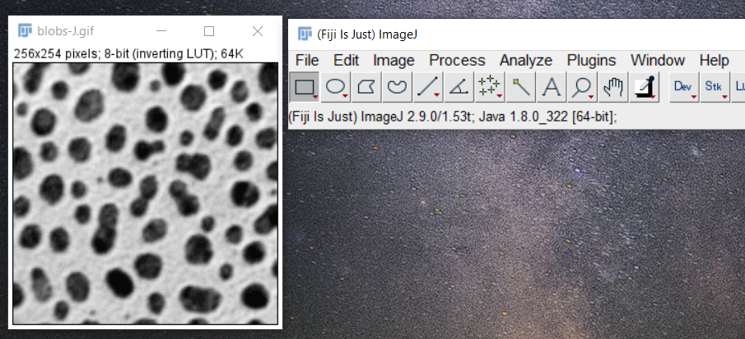
Renamed to blobs-J.gif

Slide 45
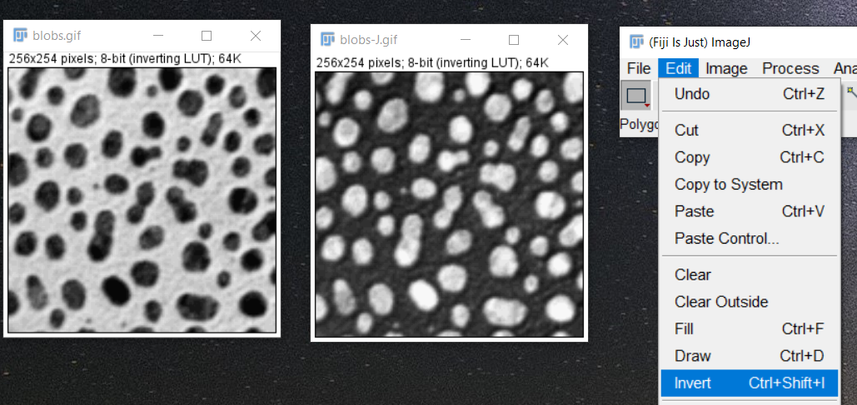
Cell counting/Segmentation
Highlight blob-J.gif and Edit/Invert
White low
Dark High values in the inverted blob-J.gif

Slide 46
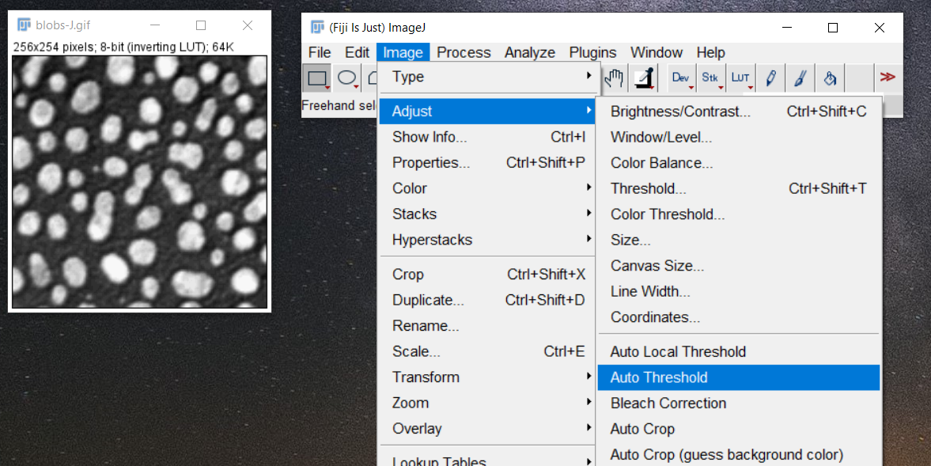
Image/Adjust/Auto Threshold

Slide 47
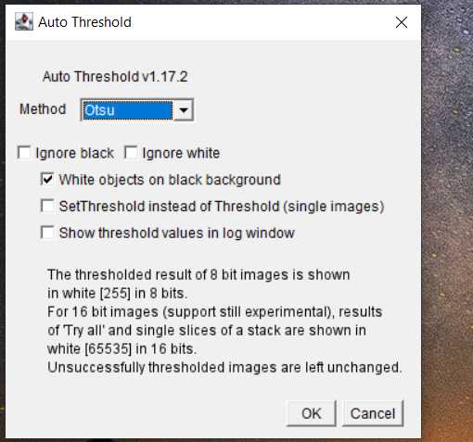
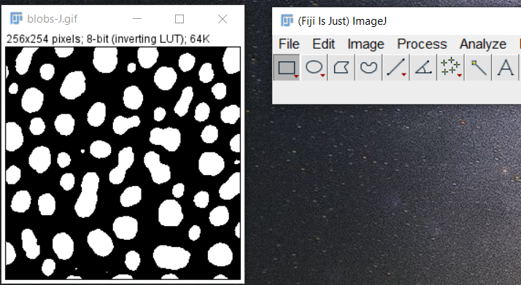





Threshold: Otsu

Slide 48
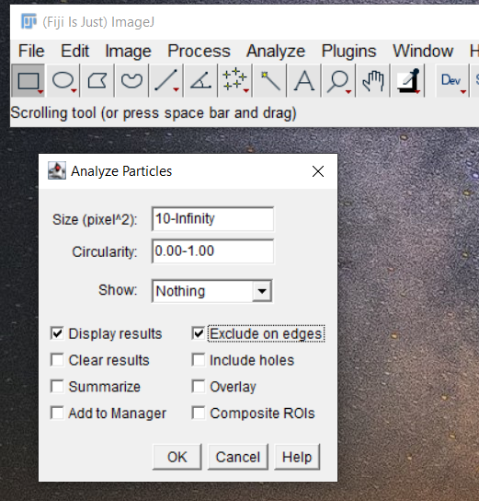
Analyze/Analyse Particles

Slide 49
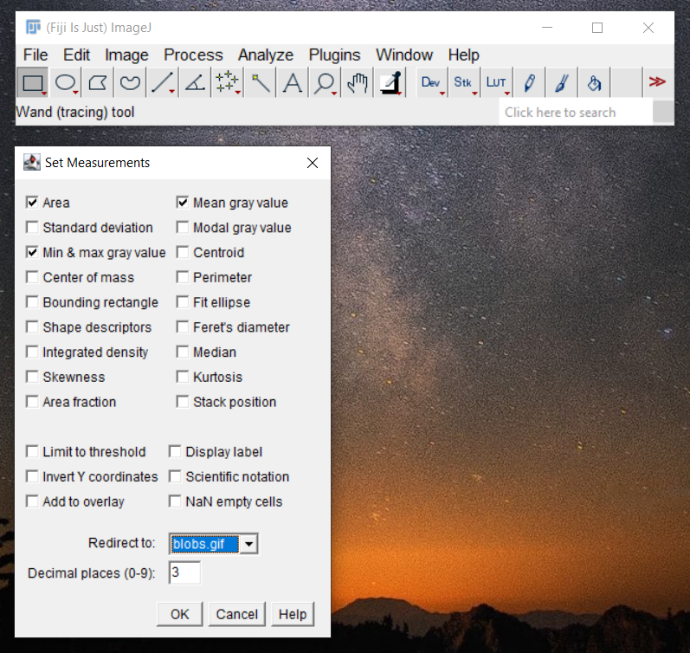
Analyze/Set Measurements

Slide 50
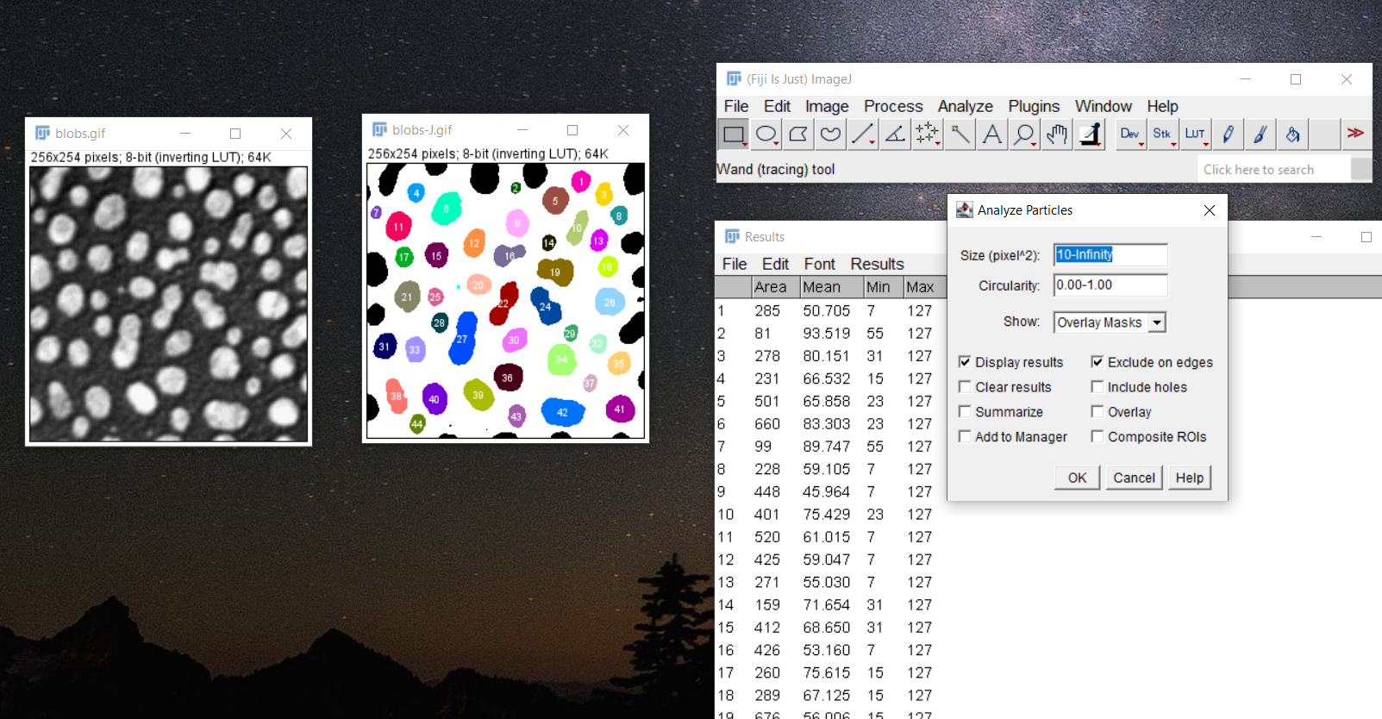

Slide 51
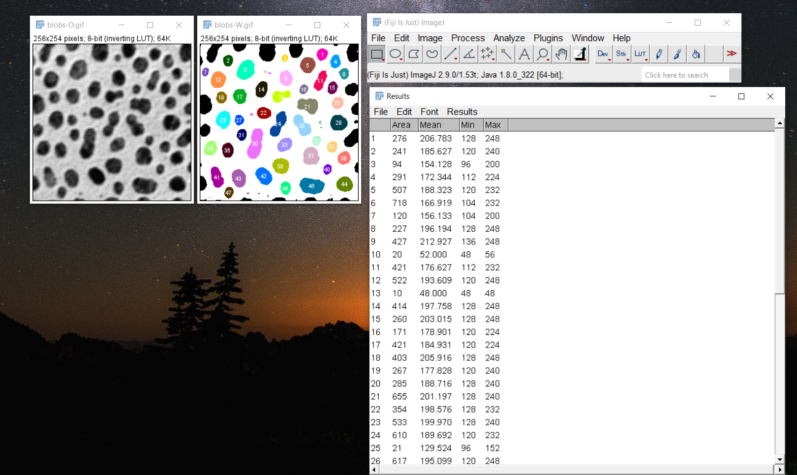

Slide 52
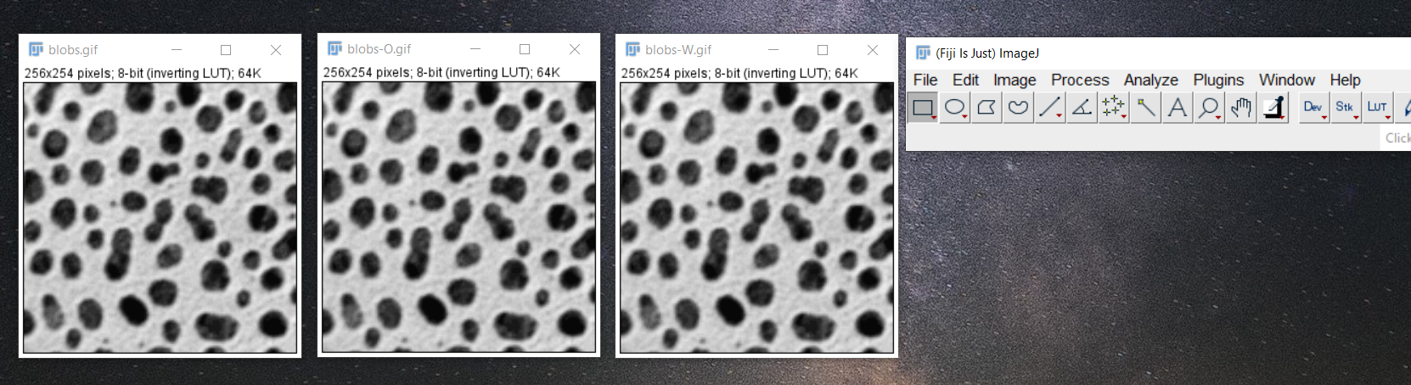
Protocol
Make duplicate copies (1) named blobs-O.gif (2) blobs-W.gif

Slide 53
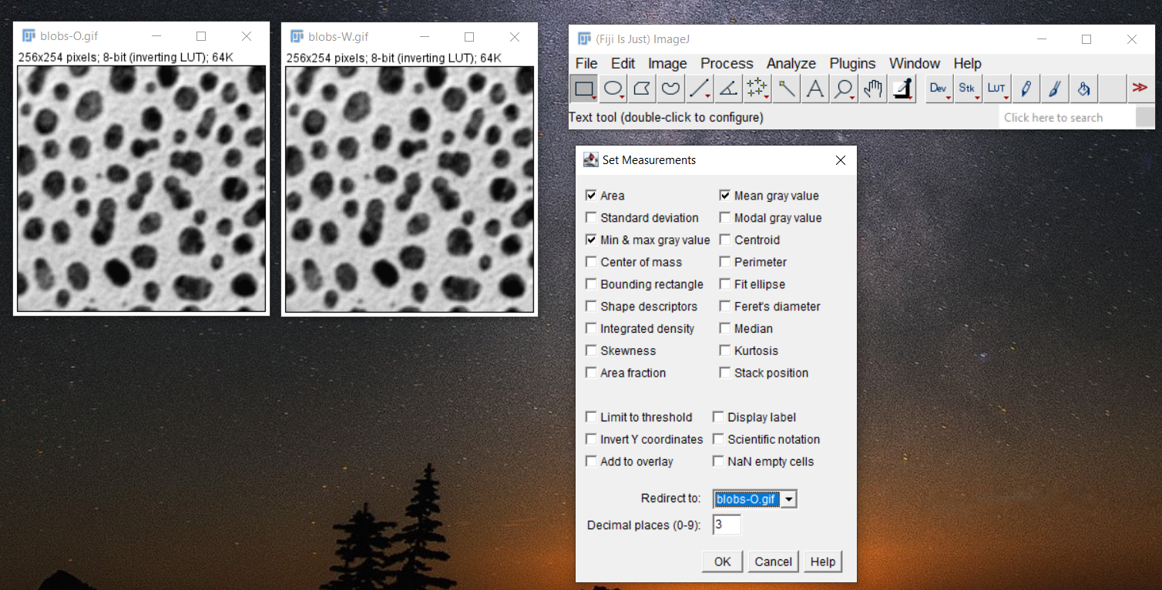
Image/Adjust/Redirect to:

Slide 54
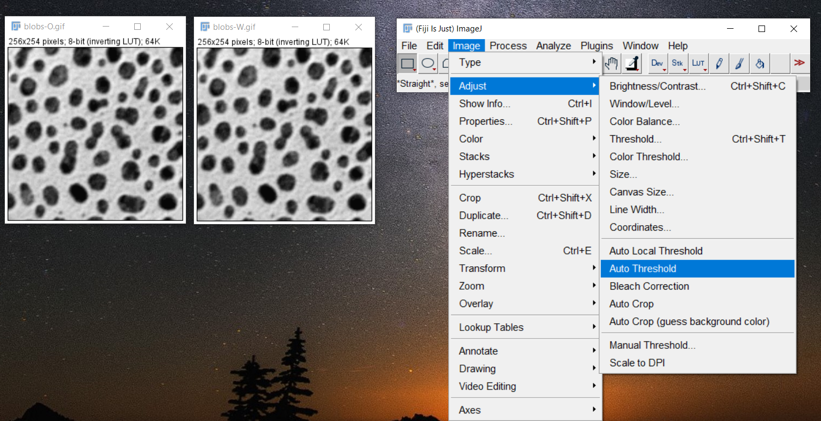

Slide 55
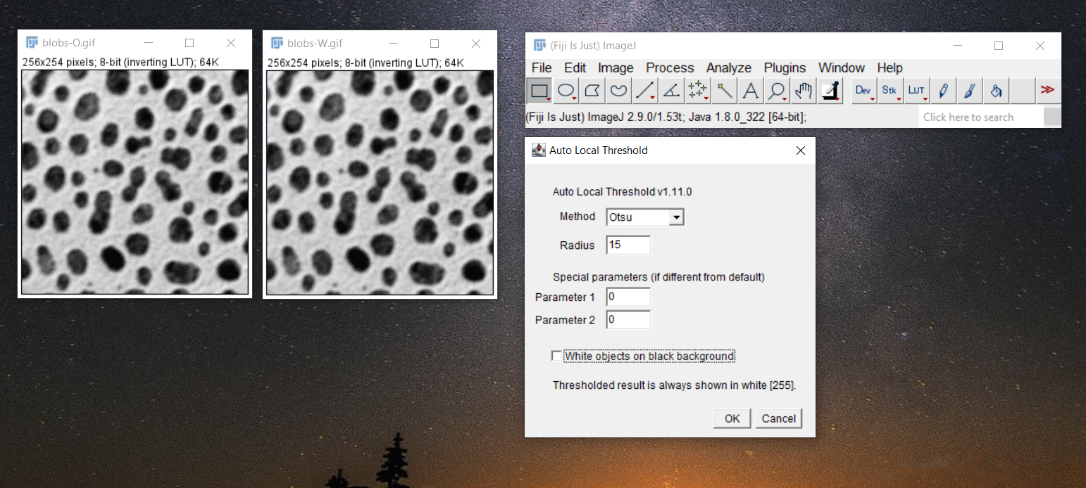

Slide 56
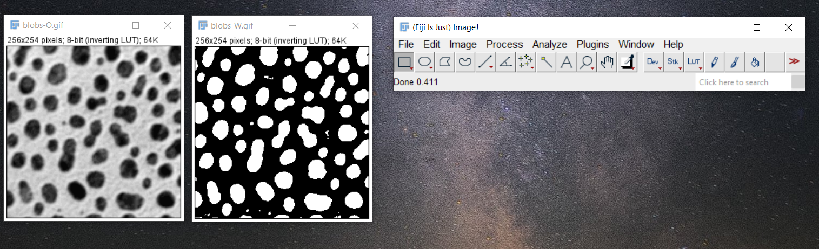

Slide 57
https://www.unige.ch/medecine/bioimaging/files/3714/1208/5964/CellCounting.pdf

Slide 58
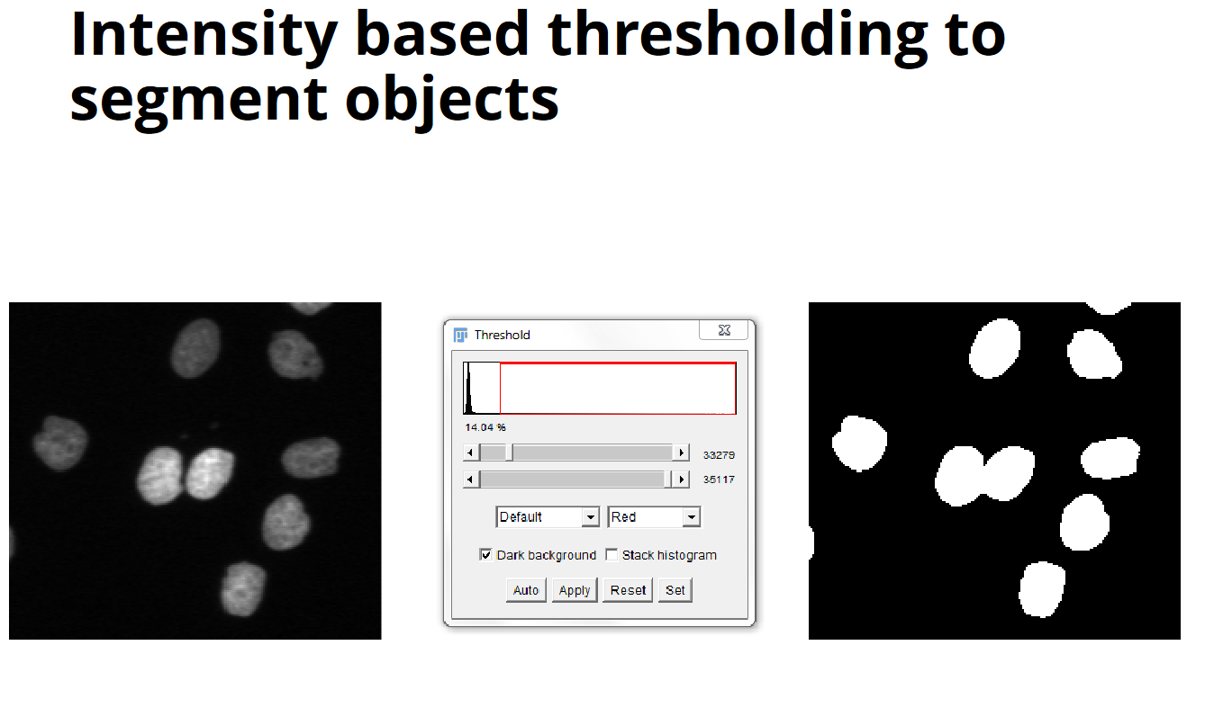
https://rawgit.com/JeremyPike/image-analysis-with-fiji/master/ImageAnalysisWithFijiSlides.pdf

Slide 59
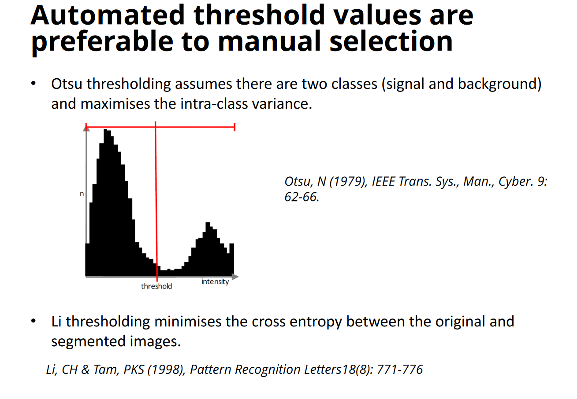
https://rawgit.com/JeremyPike/image-analysis-with-fiji/master/ImageAnalysisWithFijiSlides.pdf

Slide 60
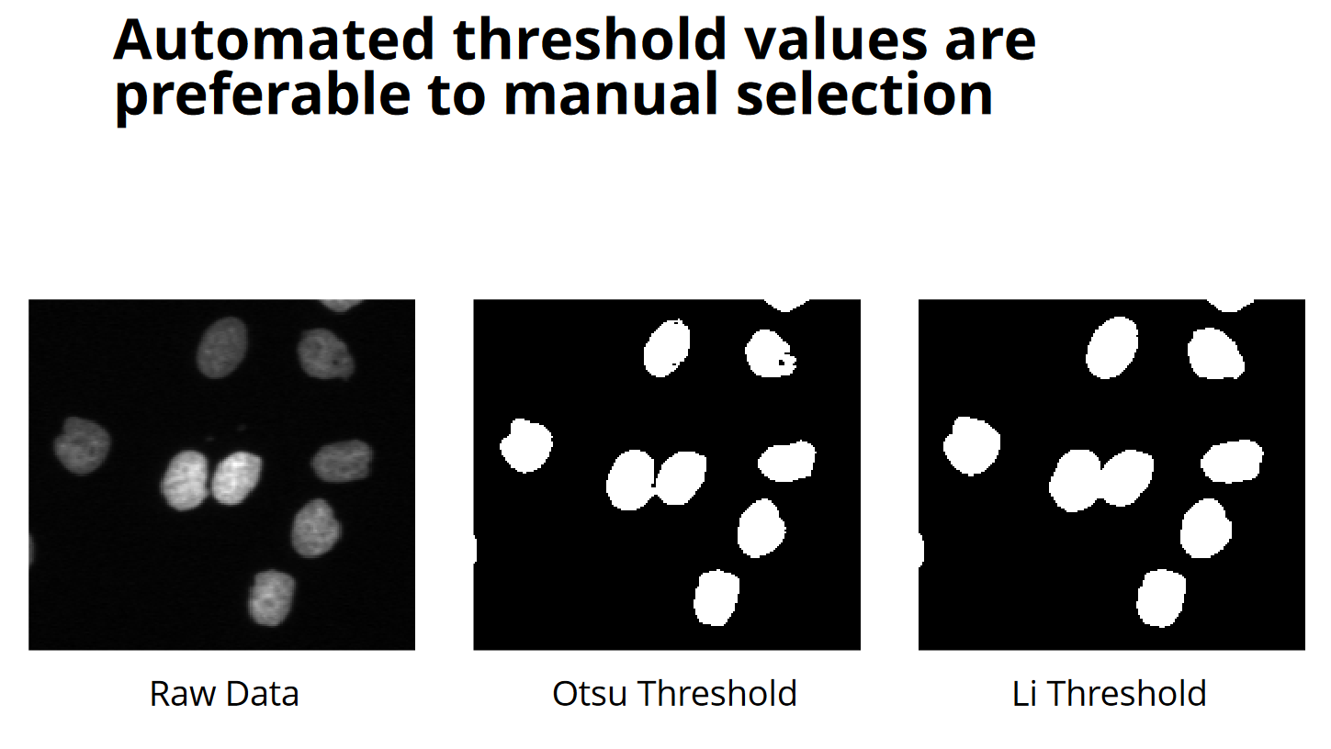
https://rawgit.com/JeremyPike/image-analysis-with-fiji/master/ImageAnalysisWithFijiSlides.pdf

Slide 61
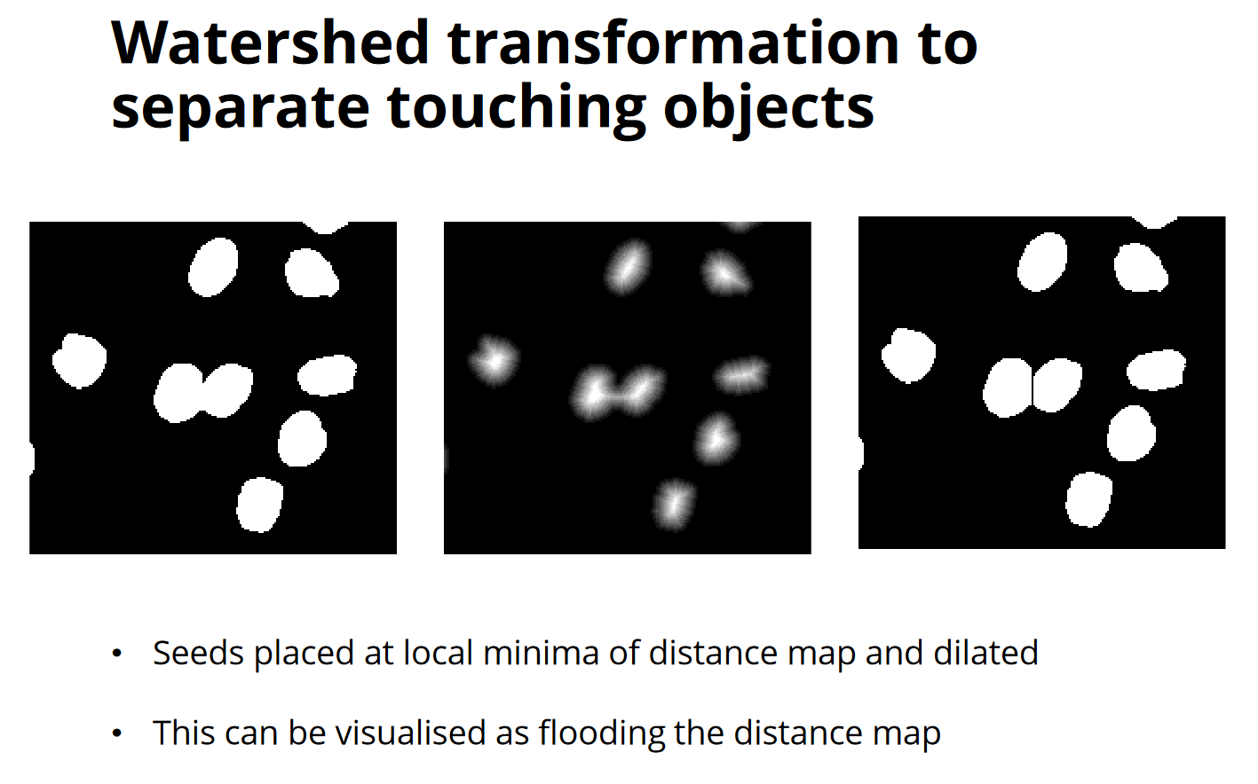
https://rawgit.com/JeremyPike/image-analysis-with-fiji/master/ImageAnalysisWithFijiSlides.pdf

Slide 62
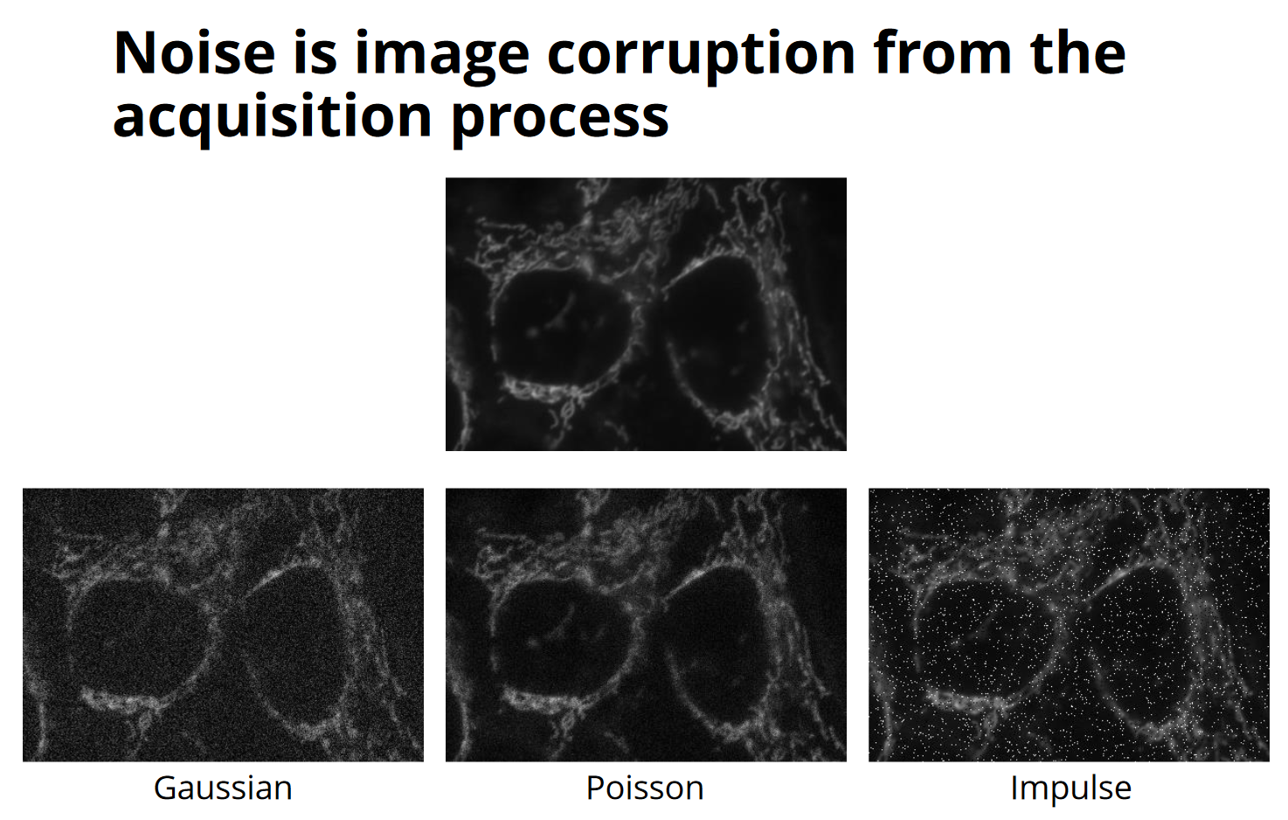
https://rawgit.com/JeremyPike/image-analysis-with-fiji/master/ImageAnalysisWithFijiSlides.pdf

Slide 63
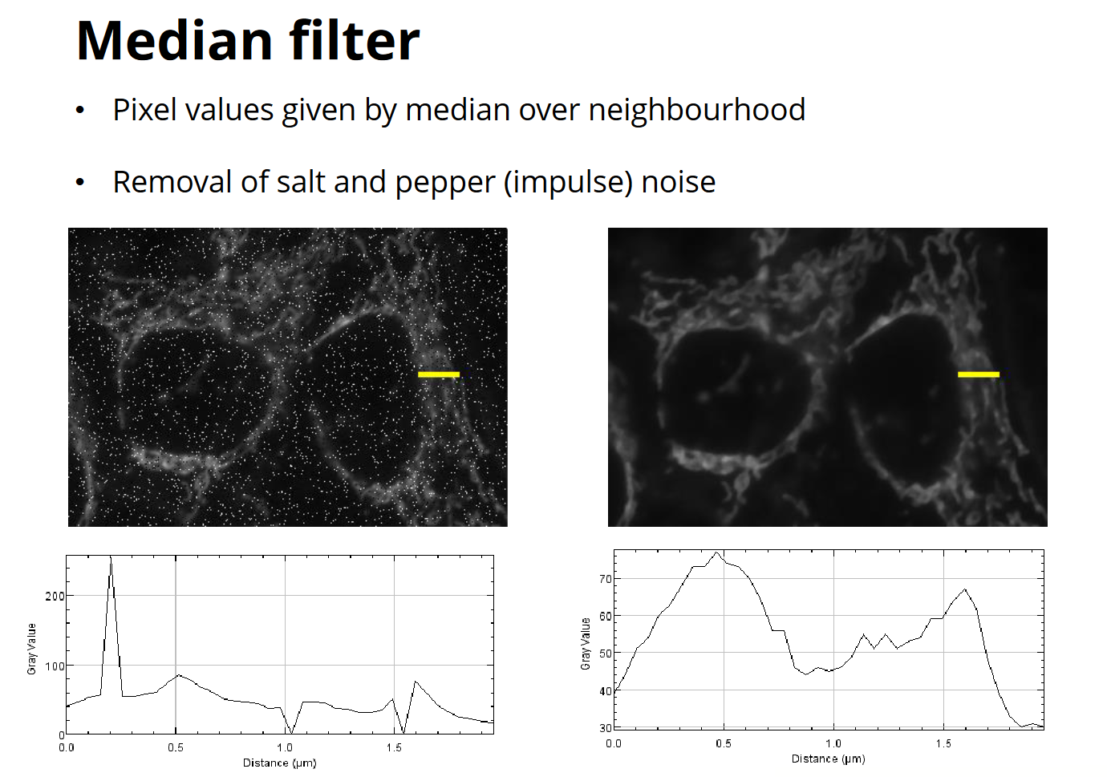
https://rawgit.com/JeremyPike/image-analysis-with-fiji/master/ImageAnalysisWithFijiSlides.pdf

Slide 64
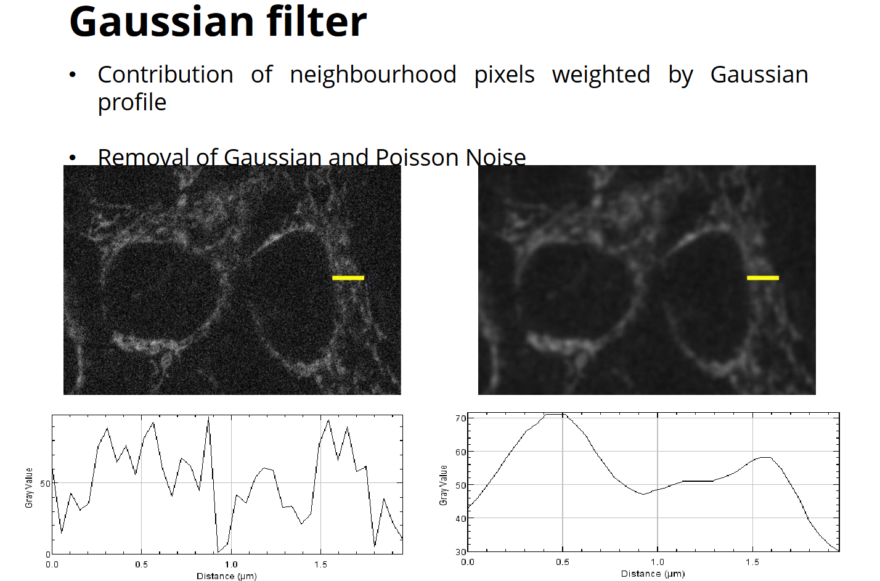
https://rawgit.com/JeremyPike/image-analysis-with-fiji/master/ImageAnalysisWithFijiSlides.pdf

Slide 65
Jupyter notebook

Slide 67
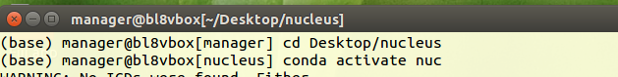

Slide 68
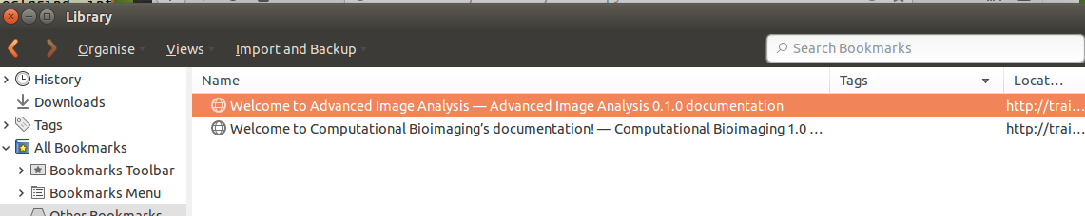

Slide 69


Slide 70


Slide 71


Slide 72
Thanks
David Waters (Computing)
Abigail (Training)

